Slide 1

Console Tetris Game
Kung Lao Team

Slide 2
Участиници
Име / Фамилия
Александър Игнатов -
Александър Павлов
Дамян Бешелиев -
Димо Петров -
Кирил Льомчев -
Кирил Стояов -
Мартин Шойлев -
Пламен Степанян -
Христо Стойчев -
Username
alboig
Alexio86
besho14
dimo.petrof
KirilLyomchev
kiril_vs
martin.shoilev
Flame78
hrist0stoichev

Slide 3

GOALS
To create console game
Dividing and milling the task.
To implement movement controlled by the player
Create sound effects

Slide 4
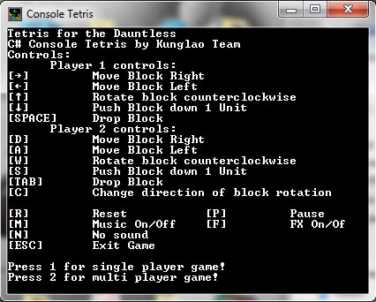
Describe
Before starting the game the user sees information with the controls:
Move left
Move right
Drop block
Push down
Rotate
The user can choose between single and multiplayer.

Slide 5
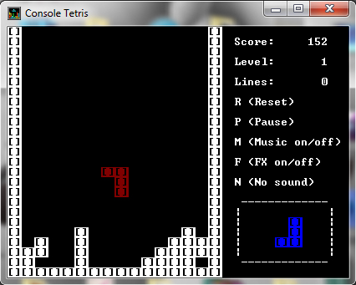
Tetris Kung Lao
It’s a classic Tetris Game. Blocks are randomly spawned with random colors and positions. On the right side of the field the user has a help menu and information about the current result, level, lines and a smaller window with information about the next block.

Slide 6
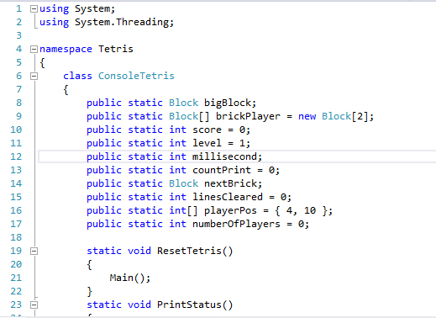
Realization
Class structure
More than 25 methods
Comments in the code
Implement the Sound Effects
Code:
https://kunglao.codeplex.com/

Slide 7
Thank you for your attention!

